Slide 1
The Jack (MA) of all Trade(RS)
Seminar 1 Group 7
Alvin Lim Swee Hung
Deionna Chee Rui Ping
Hor Chia Yee, Lara
Leow Ken Hing Bryan
Timmothy Yonathan
Notes:
Good Morning Prof, we are group 7 and my team consisting of Alvin, Lara, Bryan, Timmothy and myself will be presenting on a challenge faced by e-commerce marketplaces.

Slide 2
CONTENT OUTLINE
01
02
03
04
05
INTRO TO BUSINESS PROBLEM
BUSINESS
OPPT 1
BUSINESS
OPPT 2
BUSINESS
OPPT 3
CONCLUSION
Deionna Chee
Association Rules
Linear Regression
Quantile Regression
MARS
Time Series
Random Forest
Logistic Regression
MARS
Notes:
This will be the outline of our presentation.

Slide 3
The Business Problem
Increasing Competition Faced by E-Commerce Marketplaces from E-Commerce (Direct-to-Consumer) DTCs
Deionna Chee
Notes:
Starting off with the business problem, our team is focusing on the increasing competition faced by e-commerce marketplaces from e-commerce DTCs.

Slide 4
MARKETPLACE VS DTC
MARKETPLACE
DTC
Deionna Chee
Platform which offers products and services sold by different brands.
Model where merchants sell their products or services directly to their customers
Notes:
Before we move on to the business problem, I would to highlight the difference between marketplaces and DTCs. A marketplace is a platform which offers products and services sold by different brands. A common example in Singapore would be shopee. On the other hand, DTC is a model where merchants sell their products or services directly to their customers.

Slide 5
APPEAL OF DTC MODEL
Flexibility to Expand and Enhance Brand’s Presence
Greater Opportunities to Build Positive Customer Relationships
Increased Margins
Deionna Chee
Notes:
The increasing rate in adoption of the DTC is attributed to the benefits offered by the model. The three benefits that we have identified are.. Firstly, the flexibility offered to brands to expand and enhance their presence as they are able to control all aspects of consumer interactions with them. Secondly, the DTC model offers greater opportunities to build positive customer relationships by allowing brands to connect directly with their customers and offer content that resonates with them best. Lastly, DTC allows for greater margins by cutting out middlemen, which is an additional cost incurred when selling on marketplaces.

Slide 6
OUR APPROACH
Deionna Chee
Business Problem 1:
Flexibility to Expand and Enhance Brand’s Presence
Business Opportunity 1:
Cost-Effective Means to Expand and Enhance Seller Presence
Business Problem 2:
Greater Opportunities to Build Positive Customer Relationships
Business Opportunity 2:
Fostering Positive Seller Impressions and Customer Relations
Business Problem 3:
Increased Margins
Business Opportunity 3:
Business Strategy Excellence through Understanding of Customer Lifetime Value (CLV) Trends and Drivers
Notes:
In order to tackle the increasing popularity of the DTC model and to assist e-commerce marketplaces in retaining and acquiring sellers onto their platforms, We have decided to provide substitutes and better alternatives to these three benefits, to better appeal to sellers and brands. These are classified into 3 business opportunities, which my teammates and I will elaborate on later on.

Slide 7
Our Datasets and
Data Cleaning
Deionna Chee
Notes:
Before we discuss the business opportunities, I will be sharing on the datasets we used, as well as the methods we employed to clean the datasets.

Slide 8
UCI E-Commerce (DTC) Dataset
Deionna Chee
Data Cleaning Steps
Handling missing/abnormal values.
Removing of rows with missing CustomerIDs.
Assigning average price of product to transactions with Unit Price = 0.
Handling non-purchase transactions.
Filtering them via InvoiceNo and Quantity and removing them afterwards .
Handling cancelled transactions.
Matching them to their corresponding order transaction.
Derived variable
a new ‘Product Variations’ column from StockCode.
Notes:
Firstly, we used the UCI online retail dataset. UCI is a company that mainly sells unique all-occasion gifts and its online retail is a DTC e-commerce space. During the data cleaning process, we handled missing and abnormal values, non-purchase transactions and cancelled transactions. We also added a derived variable called ‘Product Variation’ from the StockCode values.

Slide 9
Olist E-Commerce (Marketplace) Dataset
Deionna Chee
Data Cleaning Steps
Selecting only transactions that are delivered.
Merging 9 raw data consisting of 9 datasets .
Handling duplicates as a result of data merging (due to reasons such as having multiple review records)
Selecting the most recent review in the final merged data.
Converting time data to the right format
From character to POSIXct object.
Notes:
The second dataset that we used is the from the company Olist, which is a brazilian ecommerce marketplace. The steps we took during the data cleaning process are,
Firstly, selecting only transactions that are delivered,
Secondly, merging the 9 datasets into 1 for easier analysis
Thirdly, handling duplicates which resulted from the merging process.
Lastly, converting the time data from character to POSIXct objects.

Slide 10
OPPORTUNITY 1
Expanding and Enhancing Seller Presence
Deionna Chee
Notes:
I will now move on to our first business opportunity,

Slide 11
Business Problem 1
Deionna Chee
The DTC model gives brands the flexibility to expand and enhance their presence by controlling all aspects of consumer interactions with the brand
Notes:
The first business opportunity is to provide a alternative way to allow brands to expand and enhance their presence, which is the appeal of the DTC model.

Slide 12
OUR APPROACH
Deionna Chee
Expanding seller presence (increased visibility)
Understanding customers’ purchasing patterns
Building more effective recommendation systems
Enhancing seller presence (increased sales to existing customers)
Notes:
Our approach is to leverage on the competitive advantage of marketplaces, which is their wealth of data, to better understand customers’ purchasing patterns. With such information, marketplaces can build more effective recommendation systems to help sellers expand and enhance their presence.

Slide 13
Association Rules -
Understanding Purchasing Patterns
Deionna Chee
Find meaningful associations and relationships between items in transactions (e.g. which group of items are commonly bought together?)
E-commerce marketplaces’ large transactional databases allow for more effective association rule mining.
Notes:
To carry out the first step, we used association rule mining to find meaningful associations and relationships between items in transactions. With large transactional databases, association rule mining is likely to be more effective.

Slide 14
Association Rules on Datasets
UCI Dataset
Olist Dataset
Deionna Chee
1 invoiceID → 1 transaction
Association rules between
products (based on ‘stockNo’)
All purchases made by a customer within the same quarter → 1 transaction
Association rules between
products (based on ‘product_id’
sellers (based on ‘seller_id’)
Notes:
We took different approaches in mining association rules for both datasets due to the nature of the transactions within the datasets. For the UCI dataset, we took all records with the same invoice ID to be a transaction and we derived the association rules between products, based on the stock number.
On the other hand, we took all purchases made by a customer within the same quarter to be 1 transaction. This is because a lot of the orders made only consist on 1 item, making it difficult to derive associations between items from the dataset. We then carried out association rule mining between the products of each transaction and also between the sellers that the customers purchase from.
<<Show results on dashboard>>

Slide 15
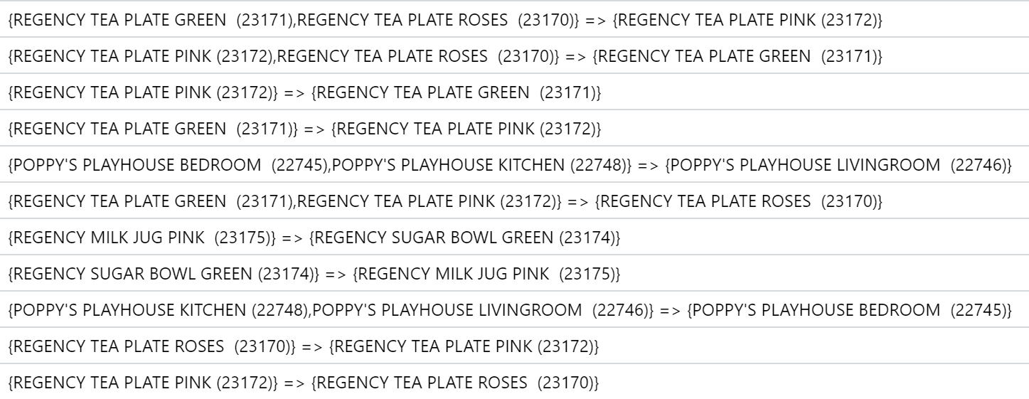
Interesting Insights (UCI Dataset)
Deionna Chee
Different variations of the same products have greater complementary effects.
Top 10 association rules in terms of lift values
Notes:
Other interesting insights from our analysis is that different variations of the same products tend to have greater complementary effects, which we concluded from higher lift values of the respective association rules. As you can see from this figure, the products purchased together are mostly the same but of different colours.

Slide 16
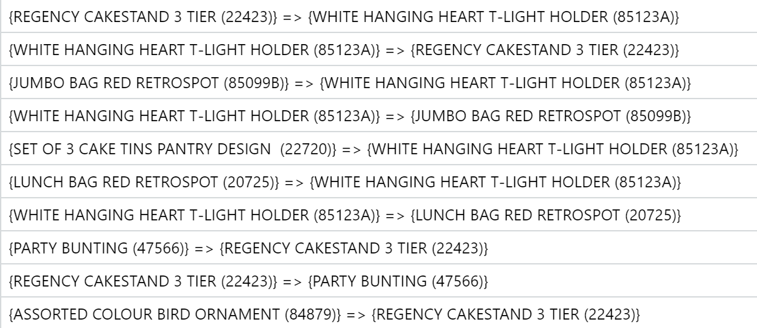
Interesting Insights (UCI Dataset)
Deionna Chee
Different variations of the same products have greater complementary effects.
Bottom 10 association rules in terms of lift values
Notes:
On the other hand, the association rules with lower lift, meaning weaker complementary effects, tend to be made up of different types of products.

Slide 17
Interesting Insights (UCI vs Olist)
Deionna Chee
The association rule mining technique was more effective on the UCI dataset as compared to the Olist dataset
Number of association rules derived from the UCI dataset (748) is much greater compared to Olist (28).
This is likely due to a larger number of records in the UCI dataset (394271 rows vs 107823 rows).
Hence, the use of association rules allows marketplaces to gain better understanding of customer purchasing patterns.
Given the advantage of having much more transactional data than DTCs.
Notes:
Lastly, we also observed that association rule mining was more effective on the UCI dataset even though it is a DTC. This is because the UCI transactional dataset consist of more rows as compared to the Olist dataset. However, In practice, marketplaces are likely to have larger transactional databases compared to DTCs to generate more association rules to better understand customers.

Slide 18
Building more effective recommendation systems
Expand Seller Presence
Enhance Seller Presence
Deionna Chee
Recommend complementary products from other sellers when products are added to customers’ carts.
Provide sellers with information on their product complements → increase sales.
Recommend complementary products from the same seller when products are added to customers’ carts
Notes:
With the help of association rules, marketplaces can build more effective recommendation systems to achieve the desired outcomes.
Firstly to expand seller presence by increasing their visibility, association rules between sellers can be used to recommend customers products from other sellers based on their purchases.
Secondly, to enhance seller presence, information on sellers’ product complements can be provided to them for them to design marketing strategies. The marketplace can also recommend complementary products from the same seller to customers based on their purchases. All of these methods are likely to help sellers boost their sales.
Now, I’ll pass the time on to lara to discuss our next business problem.

Slide 19
OPPORTUNITY 2
Building Positive Customer Relationships
Lara Hor
Notes:
Thank you Deionna, now we’ll be moving on to our second business opportunity, Building Positive Customer Relationships

Slide 20
Business Problem 2
Lara Hor
The DTC model allows brands to have direct access to their consumers through their own channels, allowing for better customer relationships through connecting with them directly
Notes:
Our 2nd business problem is that adopting a DTC model would allow brands to have direct access to consumers, and this allows for greater opportunities for the brand to connect with customers directly to build better customer relationships.

Slide 21
OUR APPROACH
Lara Hor
Provide sellers with estimated customer ratings
Using machine learning techniques
Sellers improve their customer ratings => improved customer relationships
Suggest improvements based on key variables
Notes:
To counter this, e-commerce marketplaces can build customer rapport through an alternative way that makes use of machine learning techniques. Vast amounts of data gathered by the e-commerce platform can be used to provide sellers with an estimated review score, as well as suggestions on which factors sellers can improve on by observing the important variables from our models. Providing sellers with this information can help them to improve on their customer ratings through a targeted approach, and their improved customer ratings will naturally lead to better customer relationships.

Slide 22
Linear Regression
Quantile Regression
MARS
Lara Hor
Notes:
We decided to try three different machine learning techniques, namely linear regression, quantile regression and MARS, which stands for Multivariate Adaptive Regression Splines. For data preparation, we dropped several variables in the Olist dataset that were perceived to have no correlation with review score. Before we dive into the model implementation,

Slide 23
Predicting Continuous
Review Scores
Lara Hor
Continuous Internal Rating System
Differentiation of Sellers & Products
Notes:
Let’s quickly discuss why we predicted continuous rather than discrete review scores. On the Olist dataset, review scores are discrete. However, We assume our solution of an internal rating system will be done in continuous form, so as to differentiate sellers and products further from one another.
For example, if we use a discrete internal rating system and a group of sellers all have a rating of 3, this would mean that the possibly large group sellers are of the same standard, and this is obviously not true. Giving them a more specific continuous rating would allow sellers to differentiate themselves further and also allow the e-commerce platform to give better recommendations based on more specific ratings.

Slide 24
Calculation of Model Accuracy
Lara Hor
Prediction Score ( x ) | Classified Score
X <= 1.4 | 1
1.4 < x <= 2.4 | 2
2.4 < x <= 3.4 | 3
3.4 < x <= 4.4 | 4
X > 4.4 | 5
Notes:
We created a function to calculate the accuracy of our models. Review scores in the Olist dataset are discrete and take values of 1, 2, 3, 4 and 5. However, the review score predictions generated by the models are continuous and we need to classify them to allow for appropriate comparison with the actual review scores. This table shows how we classified the scores in order to make the comparisons.

Slide 25
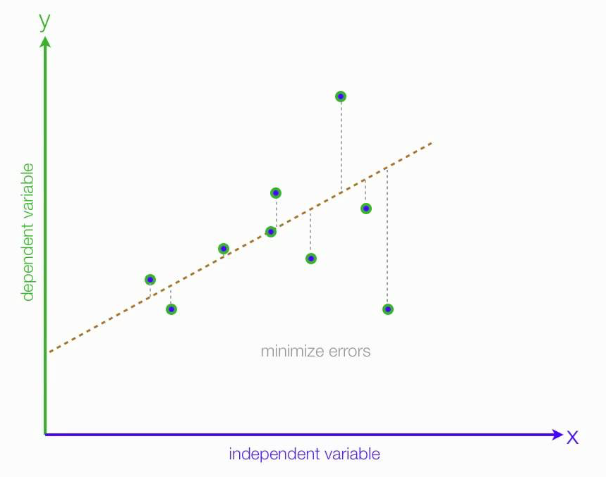
Linear Regression
Lara Hor
Notes:
The first machine learning technique we attempted is linear regression. Linear Regression is the supervised machine learning model in which the model finds the best fit linear line between the independent and dependent variable. To put it simply, it finds the best fit line by plotting the line with the least errors as you can see on the screen. In our case, the model finds the best fit line between customer review score which is the independent variable, and all the other variables in the prepared dataset, which are the dependent variables.

Slide 26
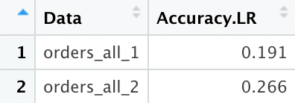
Linear Regression
Lara Hor
Notes:
We trained our model on the trainset from the original dataset and tested the model on our testset.
Next, we repeated this on the same dataset but including several derived variables.
After training both models, we attained the accuracies shown in this table. Take note that the accuracy of the model is calculated using the function derived earlier.
In the table shown on the screen, the accuracy of the model with the derived variables is greater than the one without, with accuracy rate of 0.266 compared to 0.191, but this value is still fairly low and the reason will be clear once we discuss the next slide.

Slide 27
Evaluation of Model
Lara Hor
Simple, easier to implement, interpret and train than other models
However, our dataset do not meet the 4 assumptions of linear regression:
Linearity
Homoscedasticity
Independence
Normality
Notes:
Now let’s evaluate our linear regression model. Linear regression has a simple concept and is easier to implement, interpret and train than other models. However, linear regression has 4 assumptions as shown on the screen. After plotting the 4 diagnostic plots to check whether the assumptions are met, we realise that our dataset actually fails to meet the assumptions. Thus, linear regression is not suitable for our dataset and we will hence move on to other models that are more suitable for our dataset. Now, I’ll be passing the time to Timmothy.

Slide 28
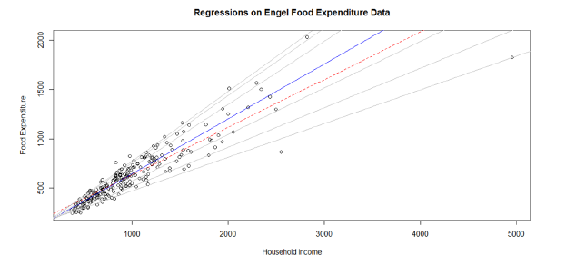
Quantile Regression
Timmothy Yonathan
Quantile regression evaluates the impact of predictor variables on a specific percentile p of the outcome variable Y.

Slide 29
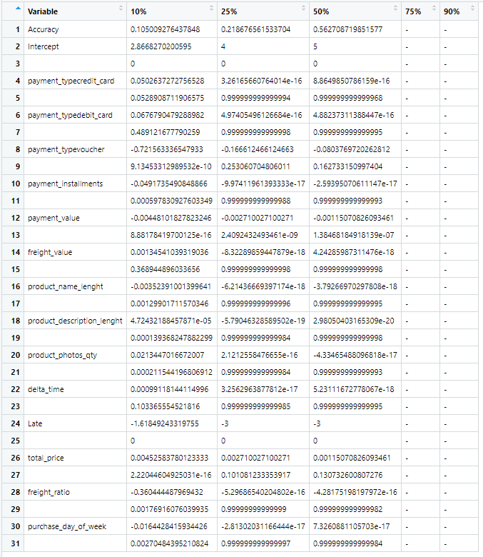
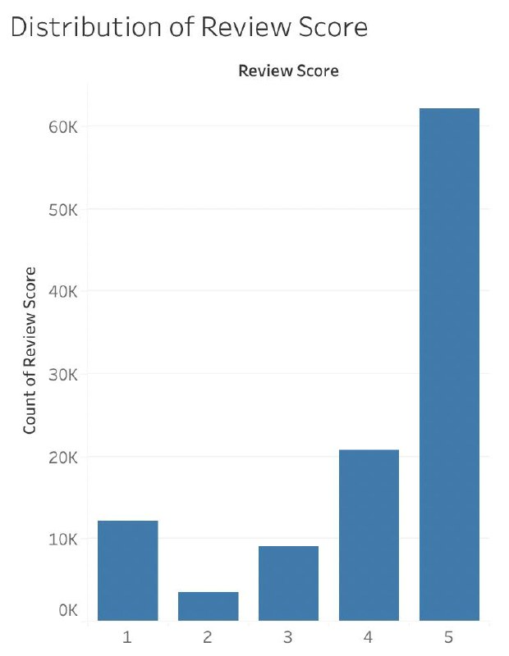
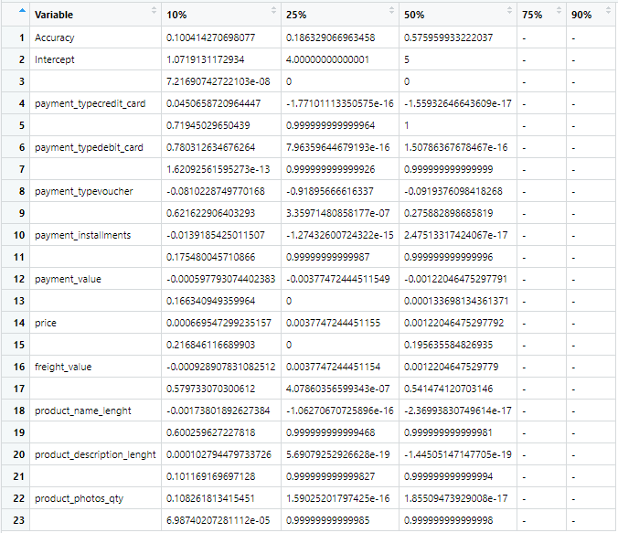
Quantile Regression Findings
Timmothy Yonathan

Slide 30
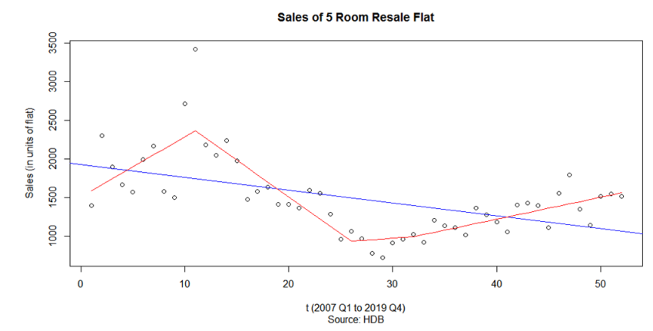
MARS
Timmothy Yonathan
MARS is a form of regression analysis that model nonlinearities between variables

Slide 31
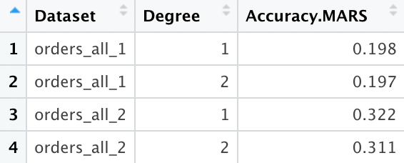
MARS Findings
Timmothy Yonathan

Slide 32
Business Opportunity Conclusion
Accurate Predictions
Generating suggestions
Timmothy Yonathan
MARS
Quantile regression

Slide 33
OPPORTUNITY 3
Understanding Customer Value
Bryan Leow

Slide 34
Business Problem 3
Bryan Leow
The DTC model allows brands to have greater margins by cutting out the platform middlemen, leading to cost savings and hence higher gross margins.

Slide 35
RATIONALE TO GO DTC
Bryan Leow
Gross Margin =
Net Sales – Cost of Goods Sold
Customer Lifetime Value (CLV)
How much each customer spends on average
Customer Acquisition Costs (CAC)
How much it costs to get new customers
Companies cutting out the marketplace platform middlemen:
Can marketplace platforms offer insights to its companies on its CLV performance and how to maximise it?
Revenue
Cost

Slide 36
RATIONALE TO GO DTC
Bryan Leow
CLV =
Average Purchase Value x Average Purchase Frequency
Total Revenue
Total Purchases
No of Purchases
No of Unique Customers

Slide 37
OUR APPROACH
Bryan Leow
Use time-series forecasting techniques
Gain knowledge on how CLV will fare over time
Sellers understand both the how and what of CLV change, informing business strategy
Use machine learning techniques
Determine the key drivers of CLV

Slide 38
Time Series
Random Forest
Logistic Regression
MARS
Bryan Leow

Slide 39
What is Time Series?
Bryan Leow
Successive data points over time
Time series can have trends: average value changes over time
Time series can have seasonality: a pattern repeats in the data
2016
2017
2018

Slide 40
What is Time Series?
Bryan Leow
Successive data points over time
Time series can have trends: average value changes over time
Time series can have seasonality: a pattern repeats in the data
2016
2017
2018

Slide 41
What is Time Series?
Bryan Leow
Successive data points over time
Time series can have trends: average value changes over time
Time series can have seasonality: a pattern repeats in the data
2016
2017
2018

Slide 42
Time Series Forecast Findings
Bryan Leow
Forecast Method: | ¹Error on Shorter Data | ¹Error on Longer Data
Without trend or seasonality | 1.74 | 0.558
With trend, without seasonality | 2.71 | 0.829
With trend, using manual²³ autocorrelation³ ³ | 1.24 | 0.351
With trend, using auto² ² autocorrelation³² | 1.50 | 0.351
¹ Error: scaled with absolute value of CLV. Measured on unseen data (‘testset’)
² Autocorrelation: relation between a present and past value
³ Model: can be configured manually (‘manual’) or automatically (‘auto’) in our
analytics software
Shorter data = UCI (~1 year). Longer data = Olist (~2 years)

Slide 43
Time Series Forecast Findings
Bryan Leow
Forecast Method: | ¹Error on Shorter Data | ¹Error on Longer Data
Without trend or seasonality | 1.74 | 0.558
With trend, without seasonality | 2.71 | 0.829
With trend, using manual² autocorrelation³ | 1.24 | 0.351
With trend, using auto² autocorrelation³ | 1.50 | 0.351
Forecasts on longer data (~2 years, right) gives us more accurate results than shorter data (~1 year, left)

Slide 44
Time Series Forecast Findings
Bryan Leow
Forecast Method: | ¹Error on Shorter Data | ¹Error on Longer Data
Without trend or seasonality | 1.74 | 0.558
With trend, without seasonality | 2.71 | 0.829
With trend, using manual² autocorrelation³ | 1.24 | 0.351
With trend, using auto² autocorrelation³ | 1.50 | 0.351
Forecasts on longer data (~2 years, right) gives us more accurate results than shorter data (~1 year, left)
Forecasts with trend using manual autocorrelation gives the best results

Slide 45
Time Series Forecast Findings
Bryan Leow
Forecast Method: | ¹Error on Shorter Data | ¹Error on Longer Data
Without trend or seasonality | 1.74 | 0.558
With trend, without seasonality | 2.71 | 0.829
With trend, using manual² autocorrelation³ | 1.24 | 0.351
With trend, using auto² autocorrelation³ | 1.50 | 0.351
Forecasts on longer data (~2 years, right) gives us more accurate results than shorter data (~1 year, left)
Forecasts with trend using manual autocorrelation gives the best results
Forecasts with trend and seasonality may be difficult to run as it requires more than 2 years of data. Running on a third dataset shows it performs better than trend without seasonality, but still worse than manual autocorrelation

Slide 46
CLV for…
Bryan Leow
Time Series
Machine Learning
An overall measure for a single time frame (month)
Compare over time frames
Use the formula
A measure tagged to each customer
Compare between customers
Use a slightly different formula based on each customer’s spending habits + clustering

Slide 47
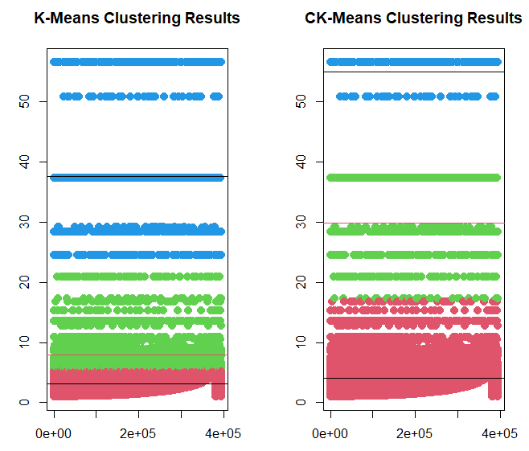
CLV for Machine Learning
Bryan Leow
Clustering of CLV variable
Segregate CLV into “Low”, “Medium” and “High”
Different methods of clustering
Lower error rate

Slide 48
What is Random Forest?
Bryan Leow
What is a Decision Tree?
A series of questions to ask about a row of data. At the end, we will reach a prediction
Is customer from Singapore?
Yes
No
Is it Monday today?
How many products did they buy?
Yes
No
>1
1
Customer has high CLV
Customer has avg CLV
Customer has low CLV
…

Slide 49
What is Random Forest?
Bryan Leow
What is a Forest?
Multiple trees created for one prediction. For classification problems, we take the majority prediction as the answer.

Slide 50
What is Random Forest?
Bryan Leow
What is a Forest?
Why is it called ‘Random’ Forest?
Multiple trees created for one prediction. For classification problems, we take the majority prediction as the answer.
Certain processes go behind the tree creation process to ensure that the trees produced are different from one another.

Slide 51
Random Forest Findings
Bryan Leow
Top 5 Predictors for UCI Dataset:
Top 3 Predictors for UCI Dataset:
Country
Month of Invoice
Day of Week of Invoice
Product Category
Freight Value
Review Score
Customer’s State
Payment Installments
Date of Purchase related variables are not the most important variable in predicting CLV

Slide 52
Random Forest Findings
Bryan Leow
Top 5 Predictors for UCI Dataset:
Top 3 Predictors for UCI Dataset:
Country
Month of Invoice
Day of Week of Invoice
Product Category
Freight Value
Review Score
Customer’s State
Payment Installments
Date of Purchase related variables are not the most important variable in predicting CLV
Cannot easily break down categorical variables, such as Product Category, into their individual categories and their respective performance

Slide 53
Logistic Regression Findings
Alvin
 | Original Trainset | Balanced Trainset
UCI Train | 1: 99.61% 2: 0% 3. 96.78% Overall: 93.92% | 1: 59.07% 2: 63.52% 3. 100% Overall: 74.20%
UCI Test | 1: 99.60% 2: 0% 3: 97.13% Overall: 93.80% | 1: 57.21% 2: 65.34% 3: 100% Overall: 58.52%
Olist Train | 1: 98.39% 2: 40.97% 3: 36.83% Overall: 91.11% | 1: 60.88% 2: 45.99% 3: 71.76% Overall: 59.54%
Olist Test | 1: 98.40% 2: 41.58% 3: 26.70% Overall: 91.34% | 1: 53.00% 2: 37.56% 3: 65.53% Overall: 51.29%

Slide 54
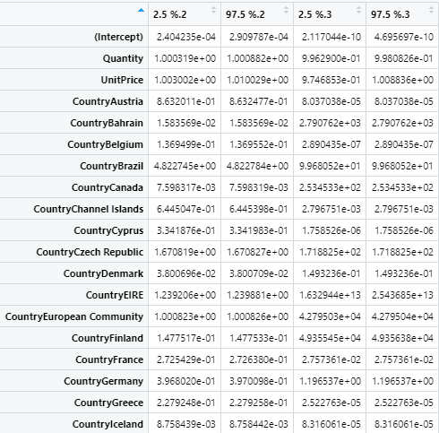
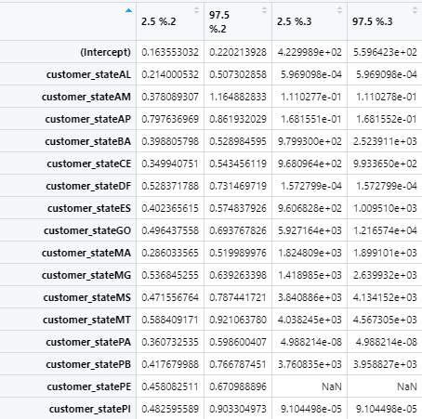
Logistic Regression Findings
Alvin
Alvin

Slide 55
MARS on Categorical Y
glm(list=family(binomial))
A B C
1 0 0
0 1 0
0 0 1
A B C
0.7 0.01 -0.2
-0.5 0.06 0.2
-0.6 0.05 1
Each level is treated as independent of the other levels
Notes:
Now let’s evaluate our linear regression model. Linear regression has a simple concept and is easier to implement, interpret and train than other models. However, after plotting the 4 diagnostic plots to check whether the linear regression assumptions are met, we realise that our dataset actually fails to meet every single assumption. Thus, linear regression is not suitable for our dataset and we will move on to other models instead. Now, I’ll be passing the time to Timmothy.

Slide 56
MARS Findings
Alvin
 | Original Trainset | Balanced Trainset
UCI Train | 1: 99.48% 2: 5.06% 3. 97.27% Overall: 94.09% | 1: 66.04% 2: 71.40% 3. 100% Overall: 79.15%
UCI Test | 1: 99.49% 2: 5.58% 3: 97.47% Overall: 94.03% | 1: 66.31% 2: 71.64% 3: 100% Overall: 67.28%
Olist Train | 1: 99.56% 2: 6.53% 3: 3.05% Overall: 87.79% | 1: 64.69% 2: 49.05% 3: 81.68% Overall: 65.14%
Olist Test | 1: 99.56% 2: 6.94% 3: 2.43% Overall: 88.18 % | 1: 57.41% 2: 39.29% 3: 65.53% Overall: 55.35%

Slide 57
MARS Findings
Alvin
Dataset | Top 3 Variable Name/Levels
UCI Original Trainset | InvoiceDate_DayofMonth InvoiceDate_MonthName, August Country, United Kingdom
UCI Balanced Trainset | InvoiceDate_MonthName, September InvoiceDate_DayofMonth Country, Finland
Olist Original Trainset | payment_type, voucher product_category_name_english, housewares product_category_name_english, construction_tools_lights
Olist Balanced Trainset | product_category_name_english, watches_gifts product_category_name_english, home_construction product_category_name_english, baby

Slide 58
Business Opportunity Conclusion
Time Series Analysis
Better prediction accuracy for UCI dataset which captures data over a shorter period
Machine Learning Models
Random Forest: High Accuracy but lack definite insights into variable importance
Logistic Regression: High Accuracy but lack conclusive insights into variable importance
MARS: High Accuracy with conclusive variable importance
Conclusive Findings
MARS solves the business problem/opportunity through high accuracy and provision of variable importance breakdown
MARS is the recommended model to use for ecommerce platforms to generate value for its sellers

Slide 59
Overall Conclusion
Alvin
Expand and Enhance Seller Presence → Association Rules
Associative insights across products and sellers
Increase in marginal and overall sales
Ecommerce offers more variety that is unmatched by any DTC
Positive Seller Impressions and Customer Relations → Quantile Regression & MARS
Quantile Regression showed higher accuracy at 50th percentile but had limitations
MARS was brought in to accurately predict customer rates
Ecommerce has a larger customer base, thus able to receive more constructive ratings
Customer Lifetime Value Maximisation → MARS
MARS is able to predict high clv customers with up to 100% accuracy
MARS provided breakdowns into variable importance levels
Ecommerce dataset has better use for machine learning due to accuracy and variable importance
“Ecommerce Platform provides more insights than DTC companies”

Slide 60
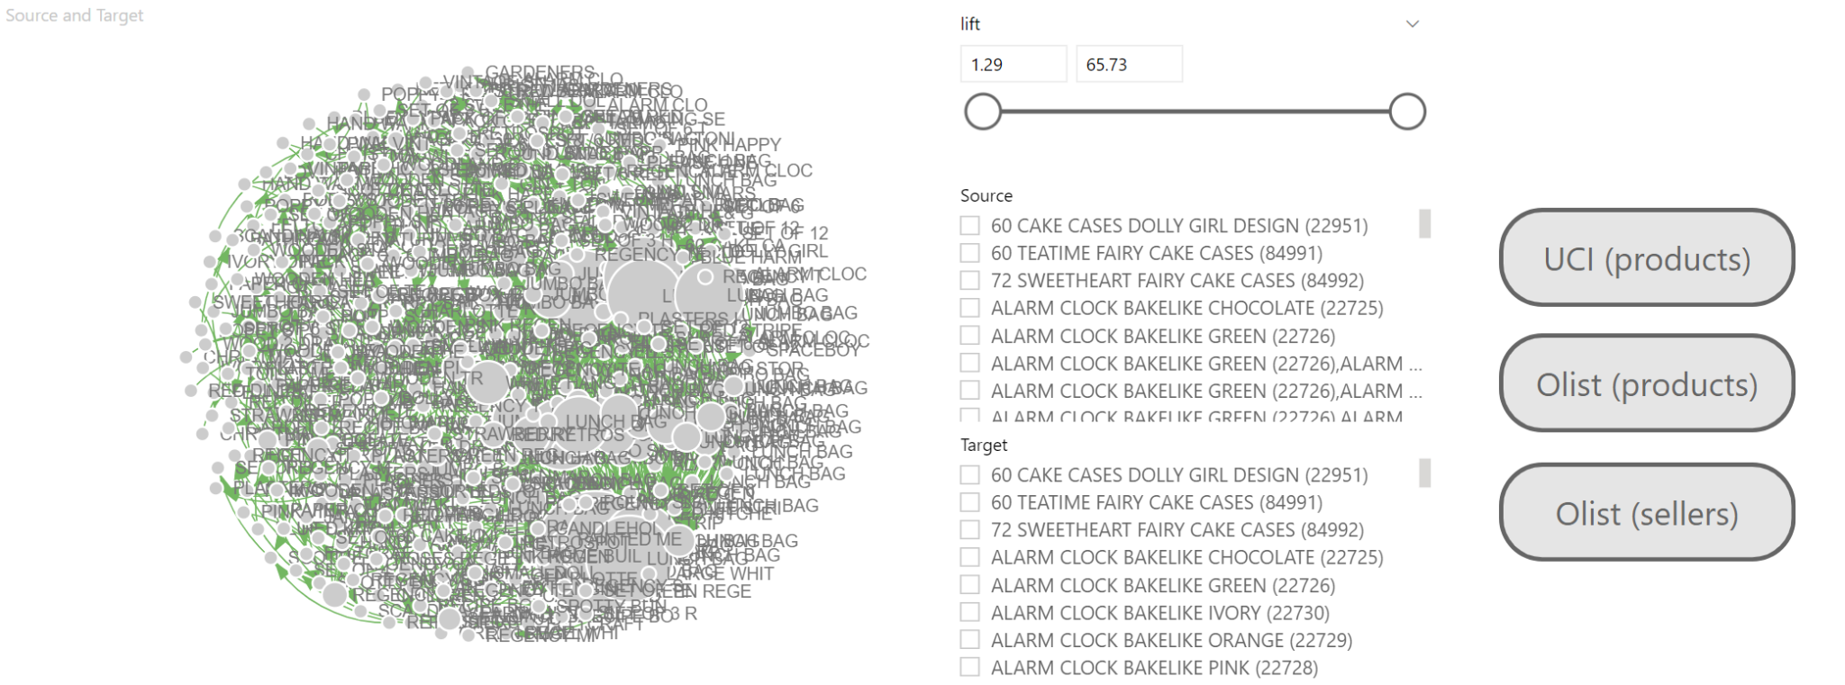
Appendix: Association Rules Dashboard
UCI (products)

Slide 61
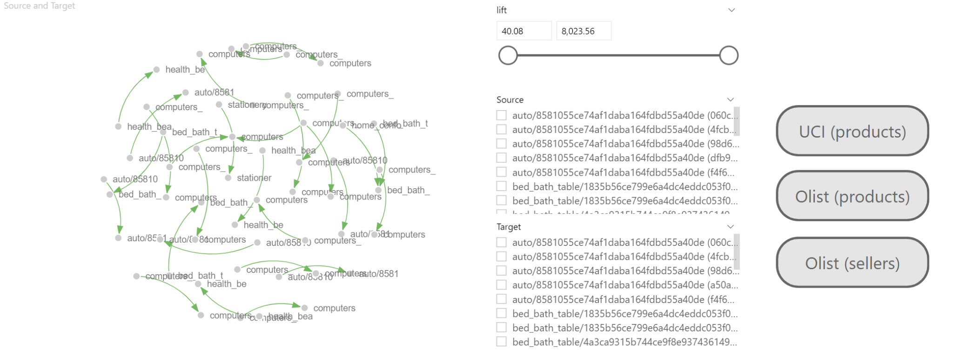
Appendix: Association Rules Dashboard
Olist (products)

Slide 62
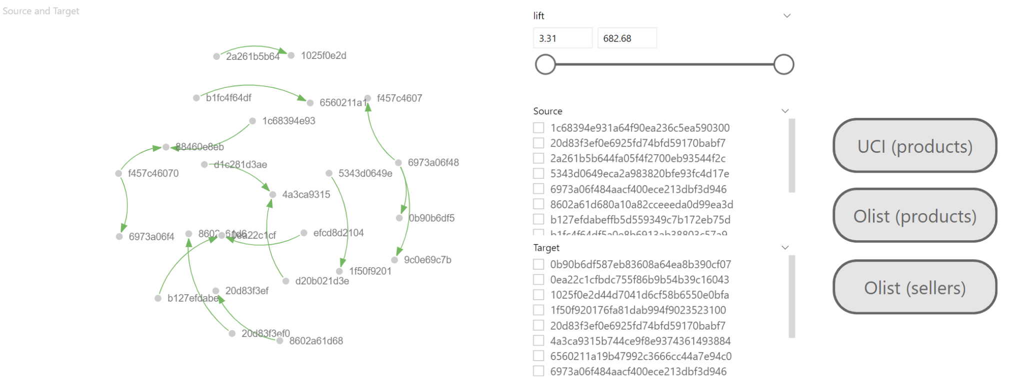
Appendix: Association Rules Dashboard
UCI (products)

Slide 63
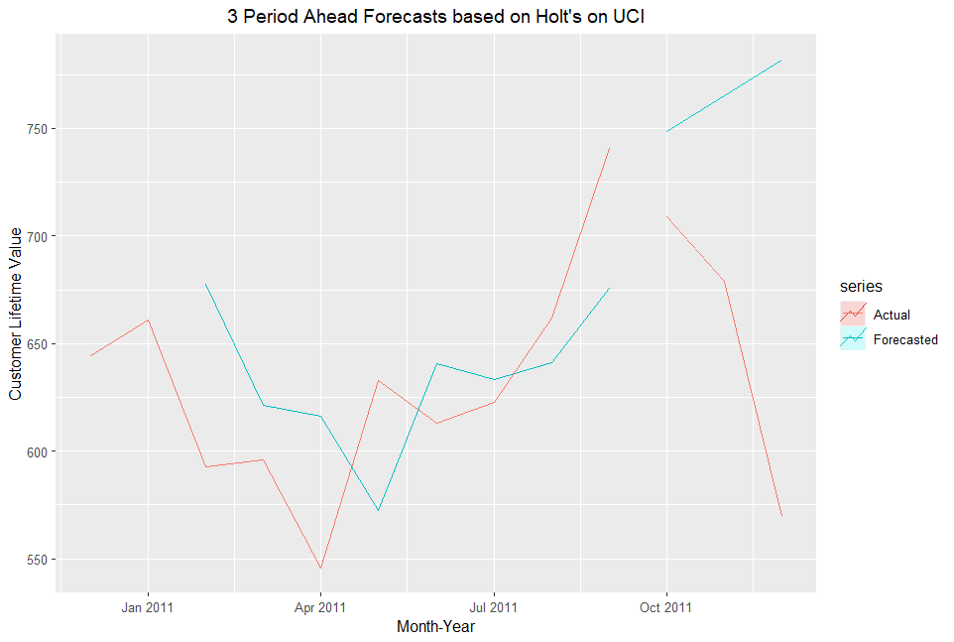
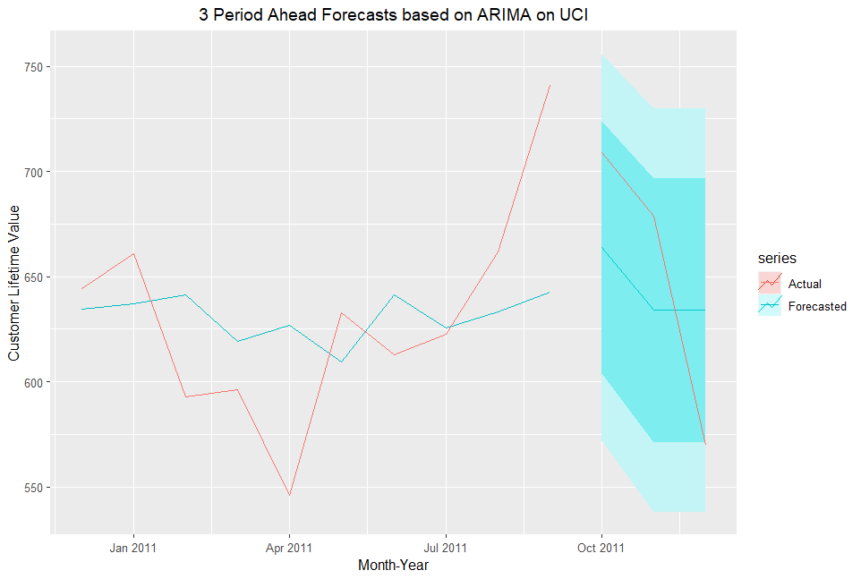
Appendix: Time Series Visualisations

Slide 64
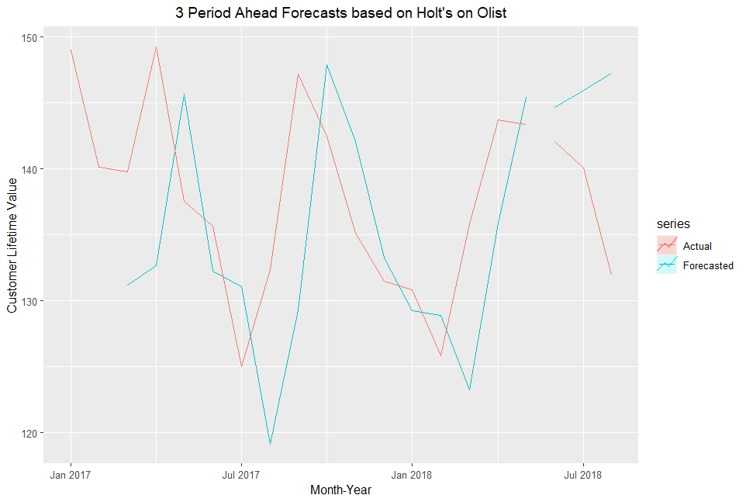
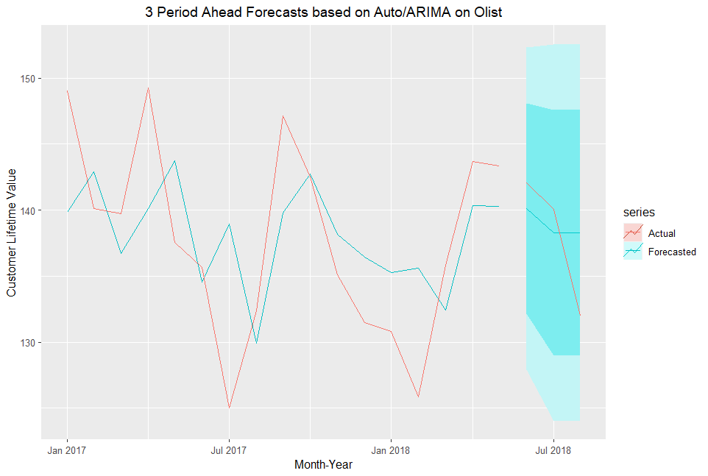
Appendix: Time Series Visualisations

Slide 65
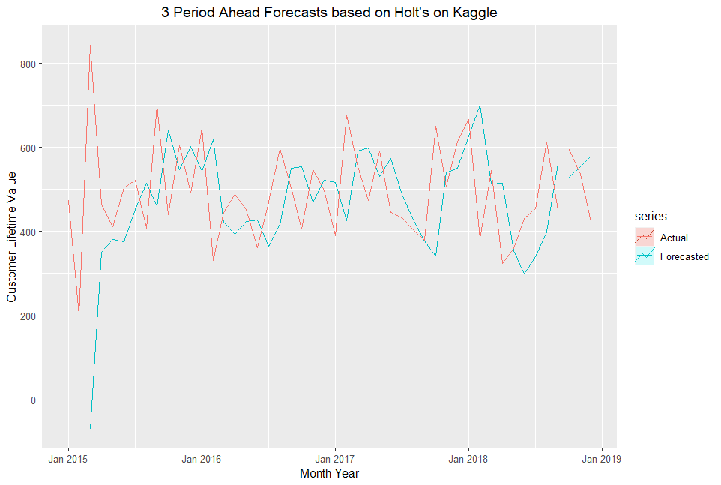
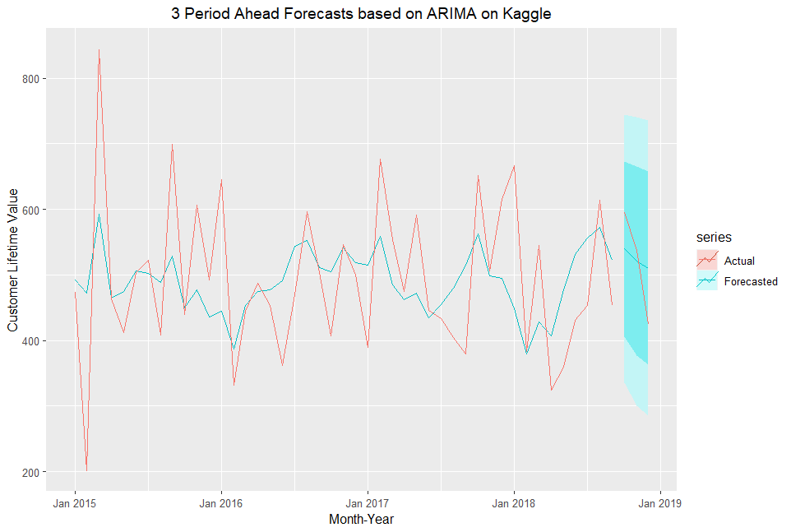
Appendix: Time Series Visualisations

Slide 66
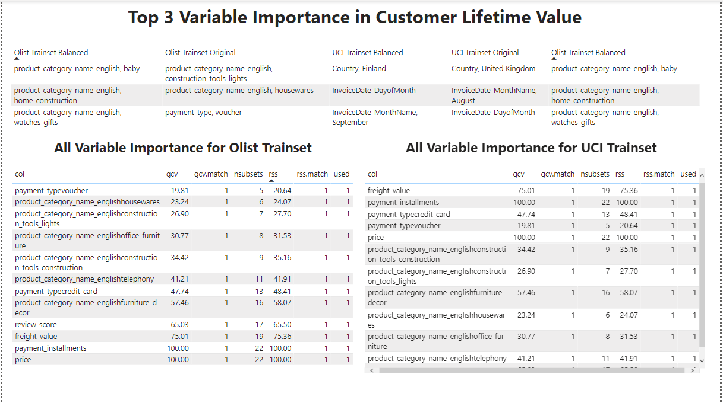
Categorical MARS Dashboard

